Slide 1


“5G SMART DIABETES TOWARDS PERSONALIZED DIABETES DIAGNOSIS WITH HEALTH CARE BIG DATA CLOUDS”
Submitted by
P.POOJA 21RG1A0540
S.ARCHANA 21RG1A0550
S.KAVYACHANDRIKA 21RG1A0552
T.AKHILA 22RG5A0506
Under the Guidance of
AVYAKTHA.E
M.TECH
ASSISTANT PROFESSOR

Slide 2
CONTENT
Abstract
Introduction
Existing System
Literature Survey
Proposed Method
Hardware & Software Requirements
Advantages
Applications
Result Analysis
Future Scope
Conclusion
References

Slide 3
ABSTRACT
Recent advances in wireless networking and big data technologies, such as 5G networks, medical big data analytics, and the Internet of Things, along with recent developments in wearable computing and artificial intelligence, are enabling
Based on our comprehensive investigation, this article classifies those methods into Diabetes 1.0 and Diabetes 2.0 which exhibit deficiencies in terms of networking and intelligence.
Thus, our goal is to design a sustainable cost-effective, and intelligent diabetes diagnosis solution with personalized treatment.
Finally, we build a 5G-Smart Diabetes tested that includes smart clothing, smartphone, and big data clouds.
The experimental results show that our system can effectively provide personalized diagnosis and treatment suggestions to patients.

Slide 4
INTRODUCTION
Diabetes is an extremely common chronic disease from which nearly 8.5 percent of the world population suffer; 422 million people worldwide have to struggle with diabetes.
More critically, the situation will be worse, as reported in with more teenagers and youth becoming susceptible to diabetes as well.
Due to the fact that diabetes has a huge impact on global well being and economy, it is urgent to improve methods for the prevention and treatment of diabetes.
The diabetes detection model lacks a data sharing mechanism and personalized analysis of big data from different sources including lifestyle, sports, diet, and so on.
To solve the above problem, in this article, we first propose a next generation diabetes solution called the 5G-Smart Diabetes system, which integrates novel technologies including fifth generation (5G) mobile networks, machine learning, medical big data, social networking, smart clothing , and so on.

Slide 5
SYSTEM ANALYSIS
EXISTING SYSTEM
5G-Smart Diabetes is a system that uses 5G technology to monitor diabetic patients and provide personalized diagnosis and treatment suggestions.
The system includes smart devices, sensors, and smartphones to collect data from the body
which is then analyzed using machine learning algorithms to make a diagnosis.
The system also includes a data sharing framework and a testbed that includes smart clothing, smartphones, and big data clouds

Slide 6
LITERATURE SURVEY
.
Chenet al. proposed the 5G-Smart Diabetes system, which combined the state- of-the-art technologies such as wearable 2.0, machine learning, and big data to generate comprehensive sensing and analysis for patients suffering from diabetes.
Rghioui et al. presented an intelligent architecture for monitoring diabetic patients by using machine learning algorithms.
Venkatachalam et al. motivated to develop a diabetes motoring system for patients using IoT device in their body which monitors their blood sugar level, blood pressure, sport activities, diet plan, oxygen level, ECG data.
Prakash et al. introduced a neural network-based ensemble voting classifier to predict accurately the diabetes in the patients via online monitoring.
Tsoulchas et al. proposed a model to monitor the health of people with diabetes melitus, a disease with high incident rates mainly at the elderly but also in younger people.

Slide 7
PROPOSED METHOD
In proposed work, we are using Decision Tree, SVM, Artificial Neural Network algorithms from python to predict patient condition from his data. To train these algorithms we are using diabetes dataset. To predict data efficiently author is using Ensemble Algorithm which is combination of Decision Tree, SVM and ANN algorithm. Training model of all these three algorithms will be merging inside Ensemble Algorithm to get better accuracy and prediction.
Personalization: In this technique one patient can share his data with other patient based on distance between cloud servers they are using to store data. Here we are using dataset so sharing is not possible but i am making all predicted test data values to be open so all users can see or share it.
Smartness: this technique will be considered as smart as its require no human effort to inform patient about current condition.

Slide 8
HARDWARE&SOFTWARE REGUIREMENTS
HARDWARE REQUIREMENTS:
System : Pentium IV 2.4 GHz
Hard Disk : 40 GB
Floppy Drive : 1.44 Mb
SOFTWARE REQUIREMENTS:
Operating system : Windows 7 Ultimate
Coding Language : Python
Front-End : Python

Slide 9
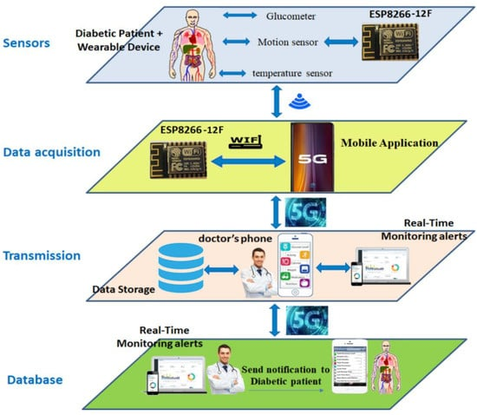
ADVANTAGES
Smartness
With cognitive intelligence toward patients' status
Network resources 5G-Smart Diabetes achieves early detection and
prevention of diabetes and provides personalized treatment to patients.

Slide 10
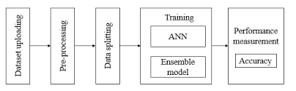
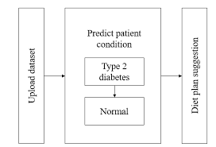
APPLICATIONS
Here we have designed two applications to implement above technique
Cloud Application: This application act like a cloud server and storage and train dataset model with various algorithms such as decision tree, SVM and ANN and Ensemble algorithms.
User Application: In this application we will upload some test data and will be consider as user sense data and this data will be sent to cloud server and cloud server will apply decision and SVM and ANN model on test data to predict patient condition and send resultant data to this application.

Slide 11
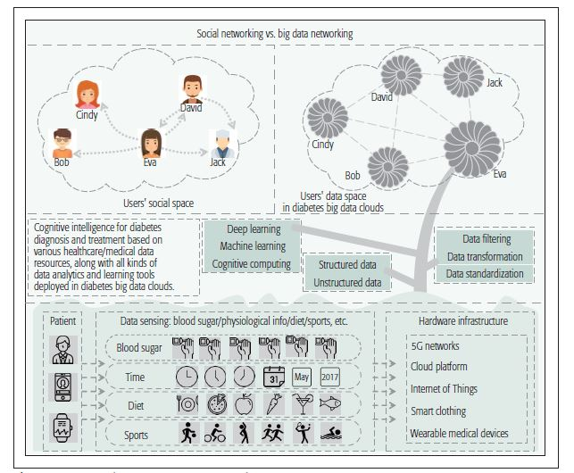
SYSTEM ARCHITECTURE

Slide 12
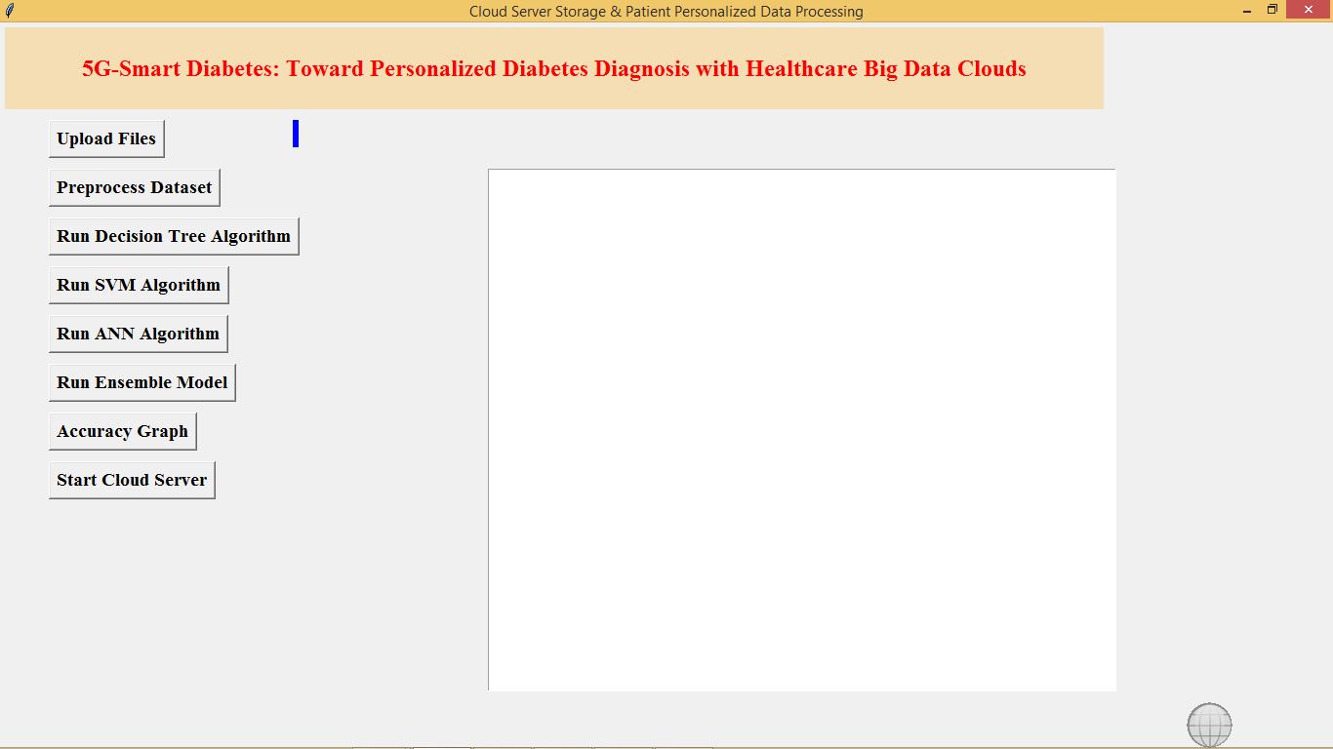
RESULT
Fig-1: Upload Files

Slide 13
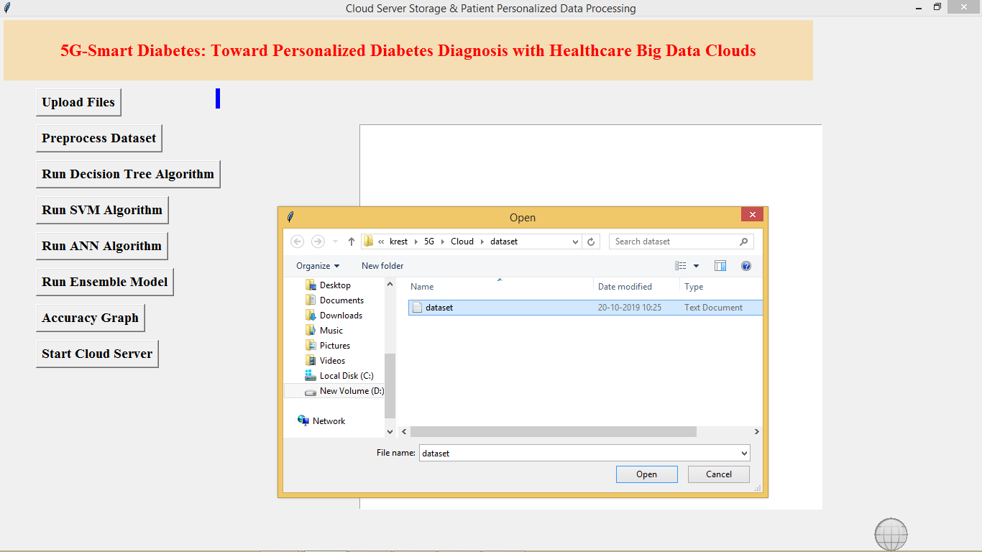
Fig-2:Pre-process Dataset

Slide 14
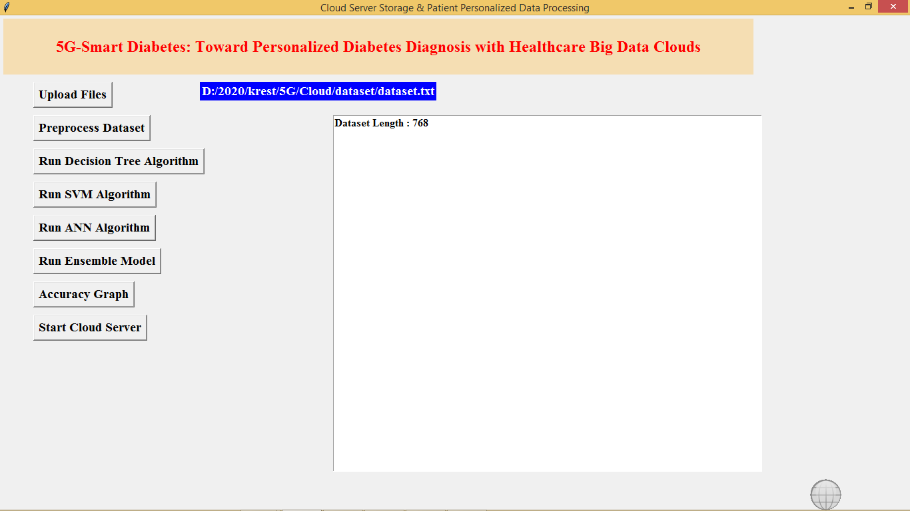
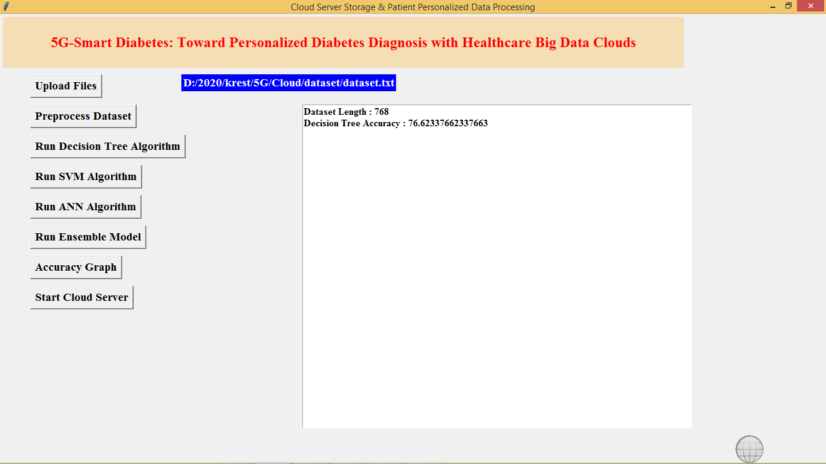
Fig-3: Run Decision Tree Algorithm
Fig-4:Run SVM Algorithm

Slide 15
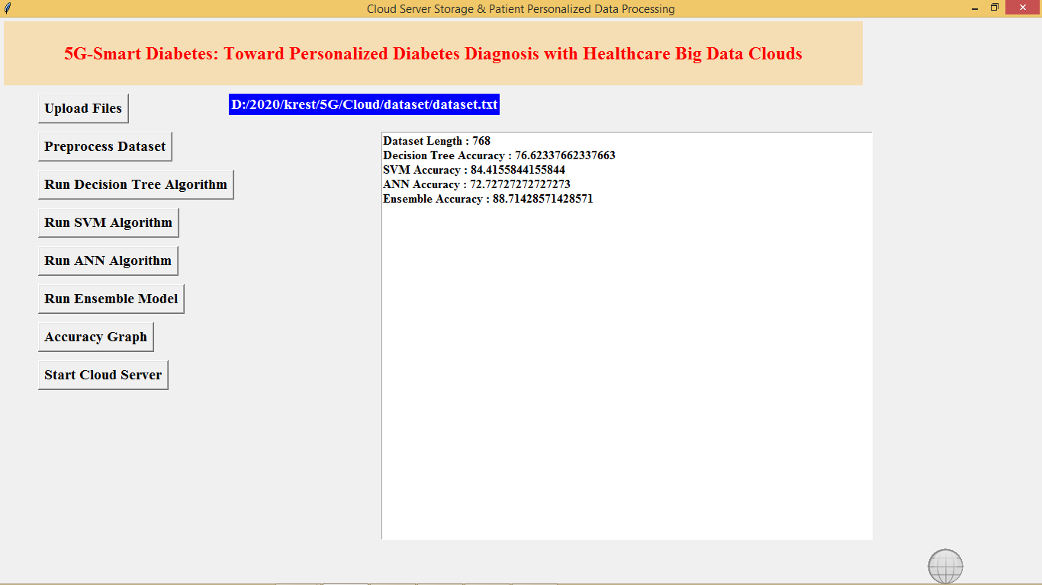
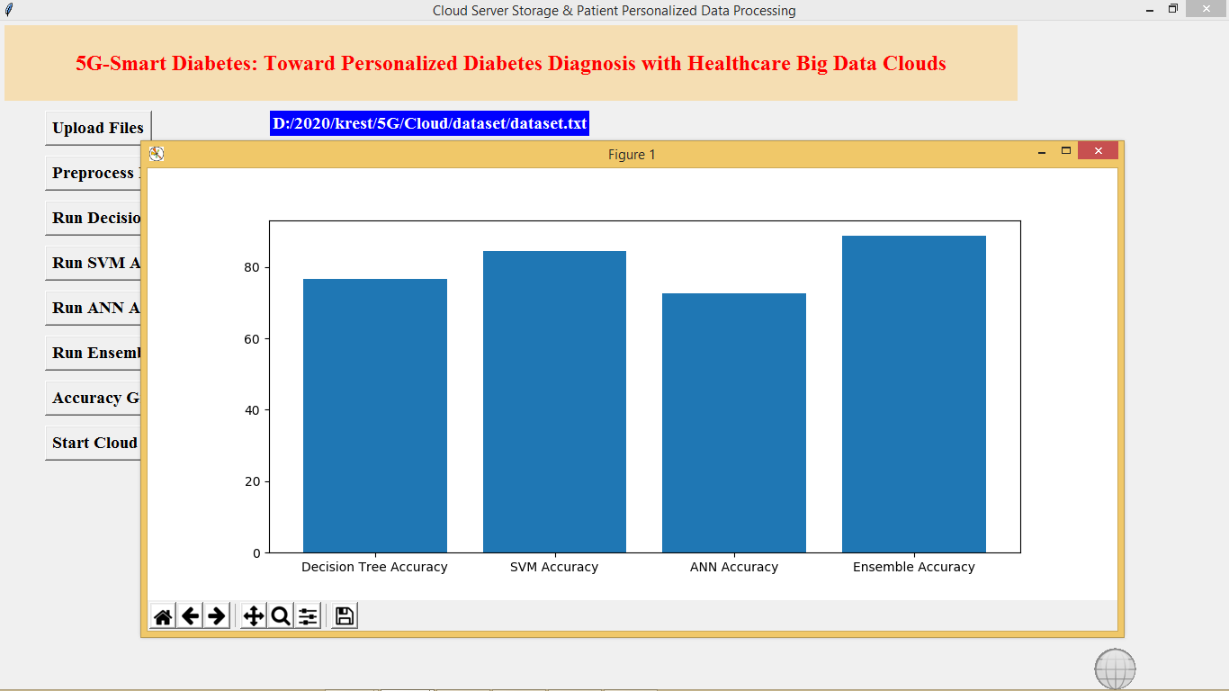
Fig-5:Run ANN Algorithm
Fig-6:Accuracy Graph

Slide 16
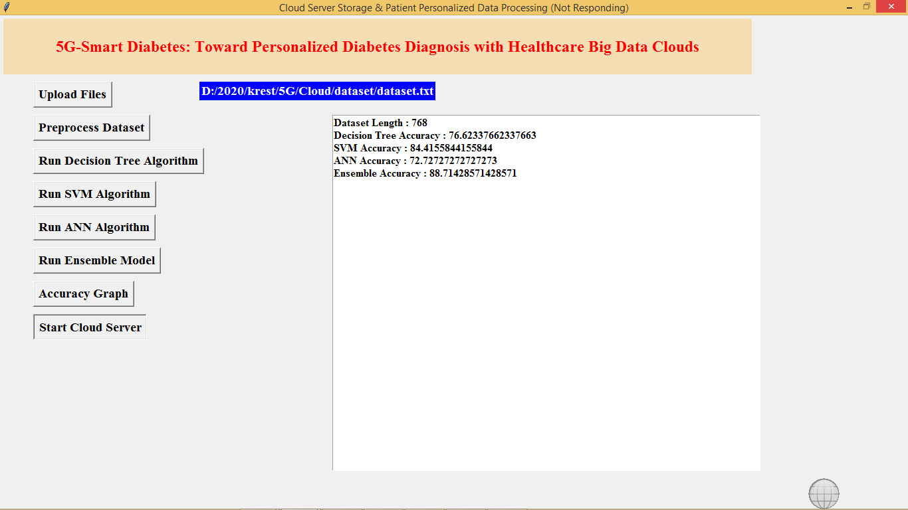
Fig-7 :Start Cloud Server

Slide 17
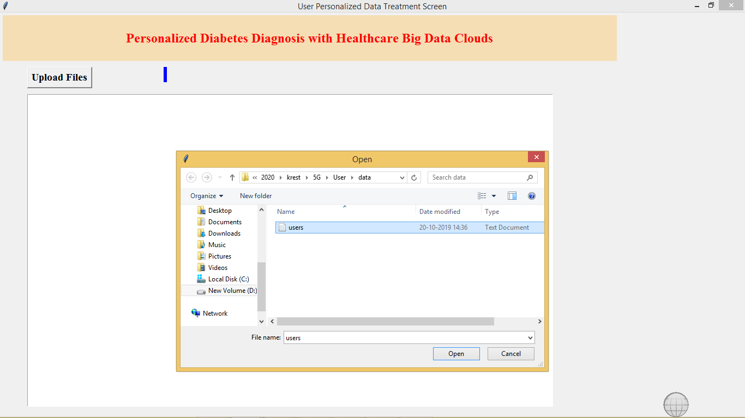
Fig-8:Upload User Details

Slide 18
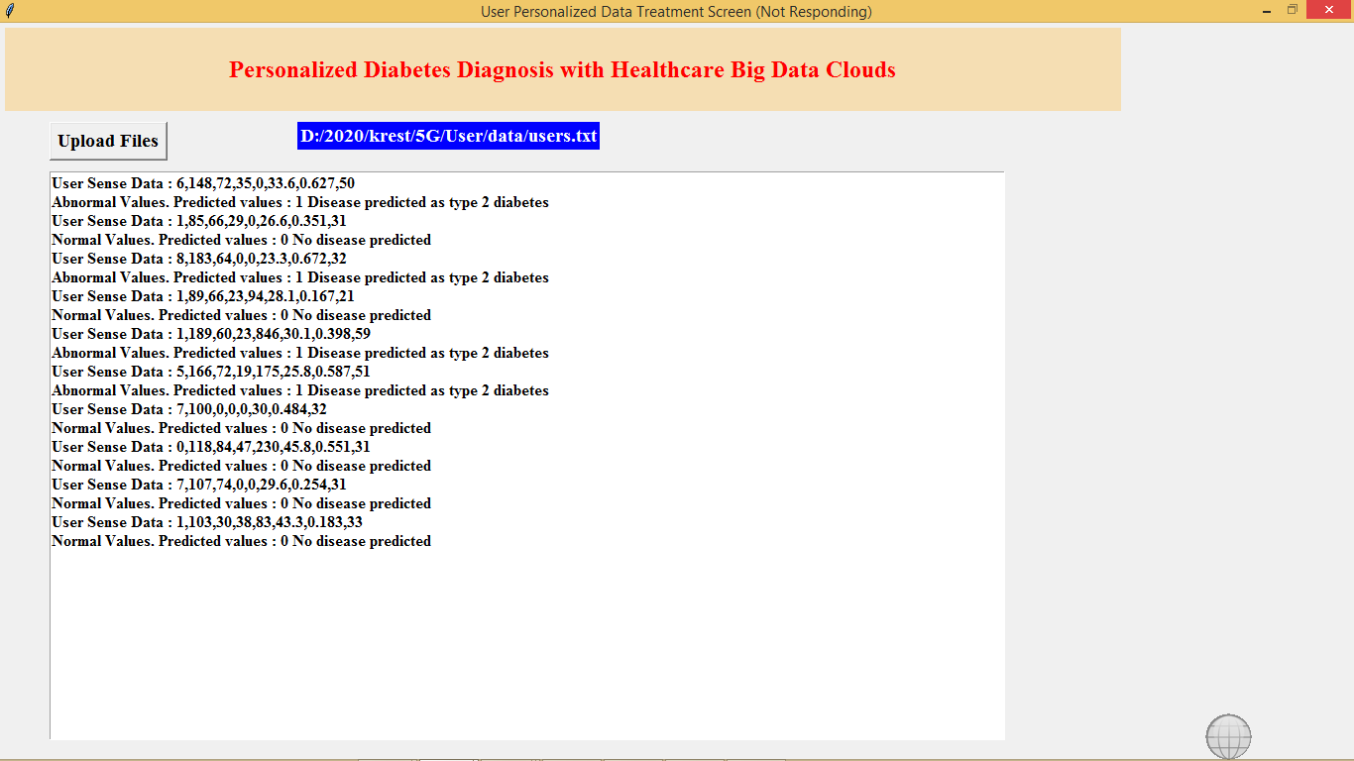
Fig 9:Details of patient

Slide 19
FUTURE SCOPE
This work extended with an intelligent architecture for monitoring diabetics patients by using machine learning algorithms.
The architecture elements included smart devices, sensors, and smartphones to collect measurements from the body.
The intelligent system collected the data received from the patient and performed data classification using machine learning in order to make a diagnosis.
The proposed prediction system was evaluated by several machine learning algorithms, and the simulation results demonstrated that the sequential minimal optimization (SMO) algorithm gives superior classification accuracy, sensitivity, and precision compared to other algorithms.

Slide 20
CONCLUSION
In this article, we first propose a 5G-Smart Diabetes system that includes a sensing layer, a personalized diagnosis layer, and a data sharing layer.
Compared to Diabetes 1.0 and Diabetes 2.0, this system can achieve sustainable, cost-effective, and intelligence diabetes diagnosis.
Then we propose a highly cost-efficient data sharing mechanism in social space and data space.
In addition, using machine learning methods, we present a personalized data analysis model for 5G-Smart Diabetes. Finally, based on the smart clothing, smartphone and data center, we build a 5G-Smart Diabetes test.

Slide 21
REFERENCES
[1] S.Mendis, “Global Status Report on Non communicable Diseases 2014,” WHO, tech. rep.; http://www.who.int/nmh/publications/ncd-status-report-2014/en/, accessed Jan. 2015.
[2] F.Florencia et al., IDF Diabetes Atlas, 6th ed., Int’l. Diabetes Federation, tech. rep.; http://www.diabetesatlas.org/, accessed Jan. 2016.
[3] M. Chen et al., “Disease Prediction by Machine Learning over Big Healthcare Data,” IEEE Access, vol. 5, June 2017, pp. 8869--79.
[4] O.Geman, I.Chiuchisan, and R.Toderean, “Application of Adaptive Neuro-Fuzzy Inference System for Diabetes Classification and prediction},” Proc. 6th IEEE Int’l. Conf. E-Health and Bioengineering, Sinaia, Romania, July 2017, pp. 639--642.
[5] S.Fong, et al. “Real-Time Decision Rules for Diabetes Therapy Management by Data Stream Mining,” IT Professional, vol. 26, no. 99, June 2017, pp. 1--8.

Slide 22


